Slide 1


21 DAYS OF
MACHINE LEARNING
13/21
---Code Warriors---

Slide 2

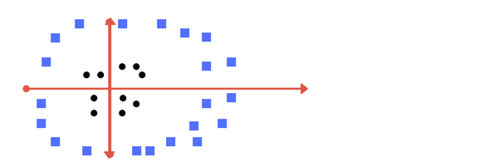
Why Support Vector Machine?
As for the real case scenario, linearly seperable data for a classification is not always possible., so we need an algo to work well with such data.
---Code Warriors---

Slide 3
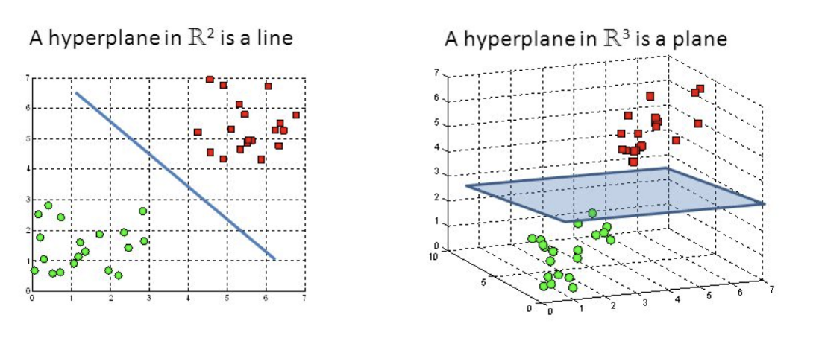
What is Support Vector Machine?
A Support Vector Machine (SVM) is a discriminative classifier formally defined by a separating hyperplane. In other words, given labeled training data (supervised learning), the algorithm outputs an optimal hyperplane which categorizes new examples.
In SVM, we take the output of the linear function and if that output is greater than 1, we identify it with one class and if the output is -1, we identify is with another class. Since the threshold values are changed to 1 and -1 in SVM.
---Code Warriors---

Slide 4
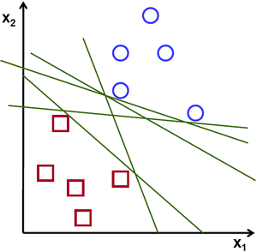
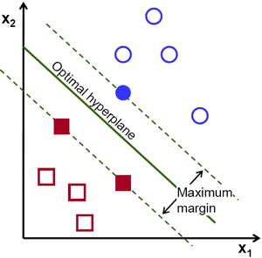
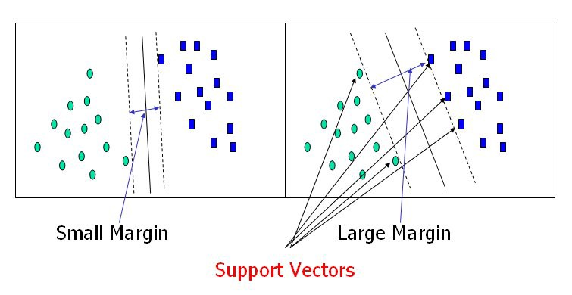
How it Works: 1
---Code Warriors---

Slide 5
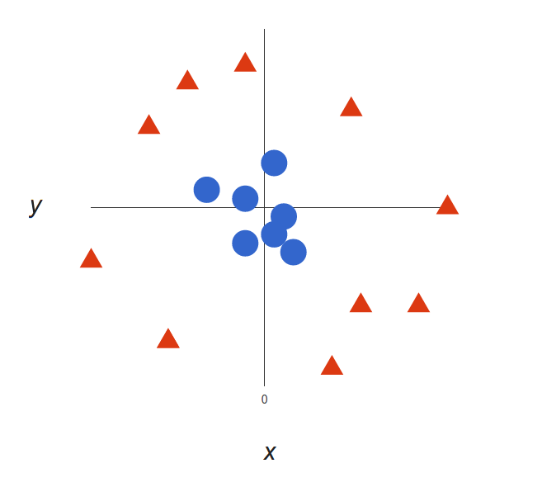
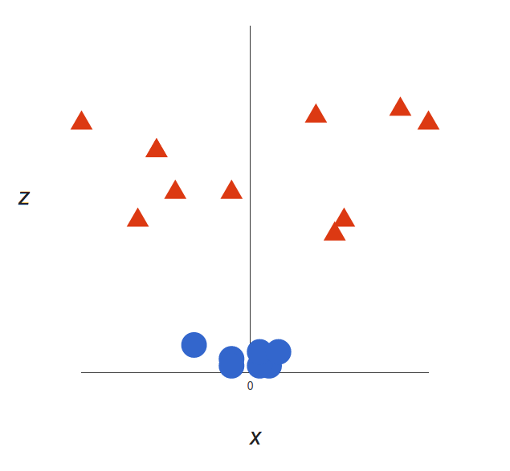
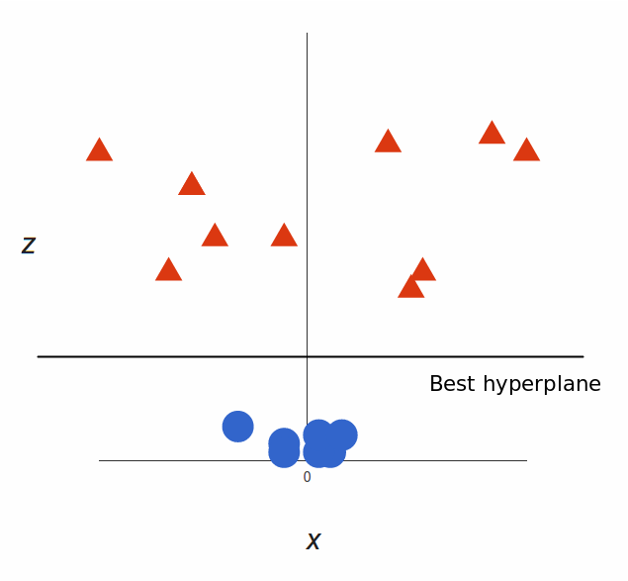
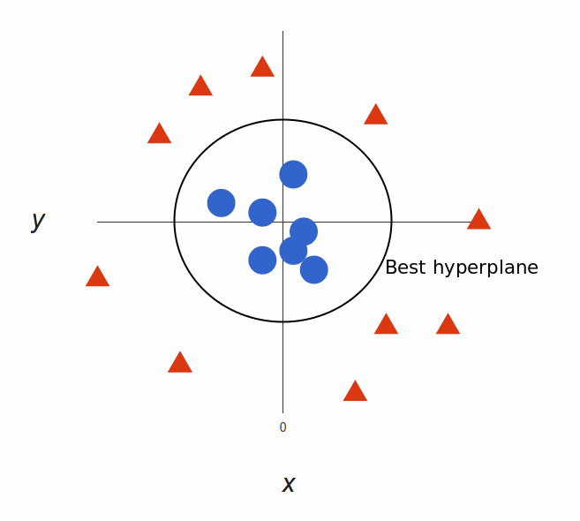
How it Works: 2
---Code Warriors---

Slide 6
Support Vector Machine
1
from sklearn.svm import SVC
2
clf = SVC(kernel='rbf')
3
clf.fit(X_train,Y_train)
4
Y_pred = clf.predict(X_test)
---Code Warriors---

Slide 7
Support Vector Machine
Advantages
Dis-Advantages
SVM works relatively well when there is clear margin of separation between classes.
SVM is more effective in high dimensional spaces.
SVM algorithm is not suitable for large data sets.
SVM does not perform very well, when the data set has more noise and sensitive to outliers.
---Code Warriors---

